Slide 1

IST722 Data Warehousing
Master Data Management and Data Governance
Business Intelligence Design and Development

Slide 2
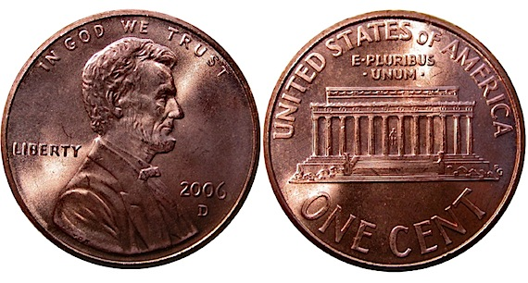
Two sides of the same coin…
MDM
DG

Slide 3
What is Master Data Management?
Creating a single “Reference Copy” of key business entities.
Examples: Customers, Vendors, Products, Employees
Offers an organization a single version of what “Customer” means.
Helps reduce inconsistencies in data distributed throughout the enterprise.
Aims to provide clean, reliable data.
MDM Systems can provide automated rules and utilities to maintain “golden records” for business entities.

Slide 4
What is Data Governance?
A committee or person acting as the administrator for the data.
Decides what is and is not master data.
Care for the data and certifies its accuracy.
Builds relationships and hierarchies among the data not found in existing systems.
Decides on “rules” for the population of MDM golden records.

Slide 5
Some Problems Can Only Be Solved With…
Master Data Management
Data Governance
Unifying disparate sources of the same data.
Cleaning up dirty data.
Establish data hierarchies and relationships not found in source systems.
Complete weighing factors in M-M dimensions.
Which components from each source are the authority?
How should the data be cleaned?
What are the rules we use to establish these hierarchies / relationships?
What formula / criteria should be used for weighing factors?

Slide 6
Example: “Students”
Applicants become Students. When? How?
Students become Alumni. When? How?
Students have Campus and Home addresses. Which one do I use?
Student goes through legal name change. Where do I change it?
Some Students are Alumni.
Some Applicants are Students.
How do you deal with the complexity of who is and is not a student? And when are and when are they not a student?
Who makes these decisions?
Where is the authoritative source for this data?

Slide 7
How does this relate to data warehousing?
MDM and DG initiatives will help us create conformed dimensions in our data warehouse, specifically when the dimensional data is sourced from multiple systems.
OLTP 1
OLTP 2
Dimension
Who decides which OLTP the dimension row comes from?
OLTP 3
OLTP 1
OLTP 2
MDM
Dimension
OLTP 3

Slide 8
Group Activity: DreamSpark Downloads
Our Goal: Track DreamSpark downloads back to the course which requires it.
The Challenge – The download is associated with 1 student, but 1 student enrolls in many courses.
How can MDM and DG Solve this Problem?
Outline a strategy.
Download SQL Svr.
M … 1
Student Bob
1 … M
Enrollment Bob IST722 Bob IST552
M … 1
Course IST722 IST522
Which course gets credit for
this download?

Slide 9
Business Intelligence Design and Development

Slide 10
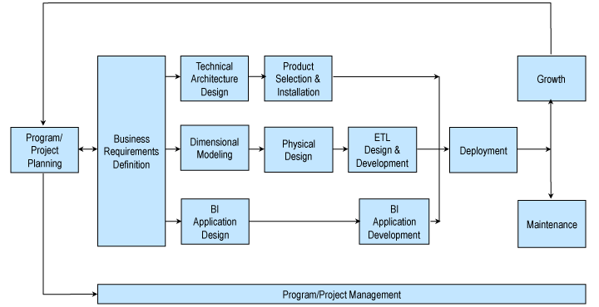
Recall: Kimball Lifecycle
Notes:
Describes an approach for data warehouse projects

Slide 11
What do you think Business Intelligence means?
When you think of BI, what pops into your head?

Slide 12
BI Defined…
Inmon
Kimball
“Systems that help make companies understand what makes the wheels of the corporation turn and to help predict the future impact of decisions.”
“A generic term to describe leveraging the organization’s internal and externals information assets to support improved business decision making.”
With whom do you agree?

Slide 13
Are these “BI”?
Four Ways to Slice Obama’s 2013 Budget Proposal https://www.nytimes.com/interactive/2012/02/13/us/politics/2013-budget-proposal-graphic.html?_r=0
Tale of 100 Entrepreneurs http://www.tableausoftware.com/public/gallery/taleof100
iSchool Class Schedule http://my.ischool.syr.edu/ClassSchedule/
Linux Kernel Activity https://github.com/torvalds/linux/graphs
Notes:
Answer to all of these is “yes”

Slide 14
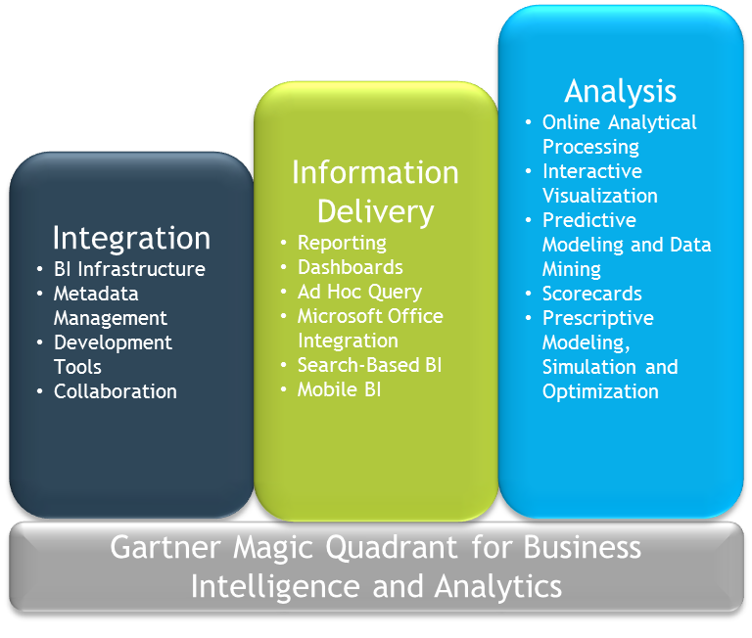
BI Components

Slide 15
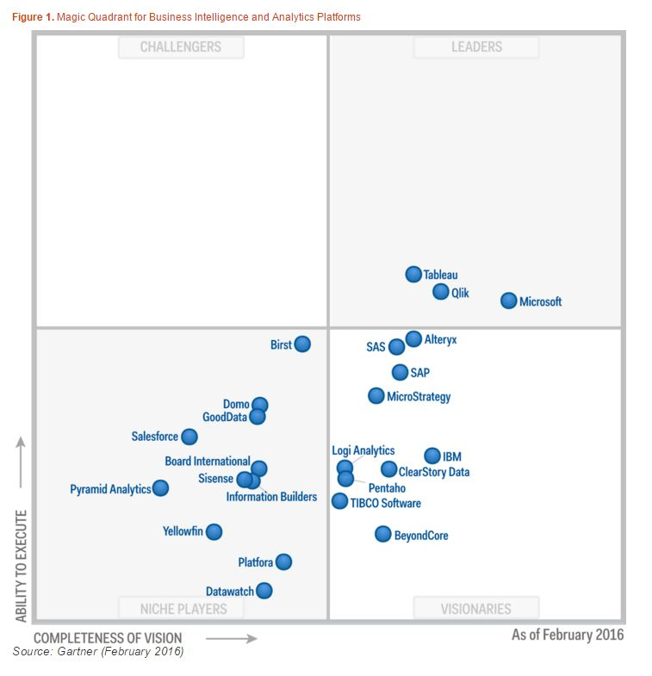
BI Players…

Slide 16
Types of BI Applications…
BI
Direct Access Query + Reporting
Data Mining
Standard Reports
Analytic Applications
Dashboards and Scorecards
Operational BI

Slide 17
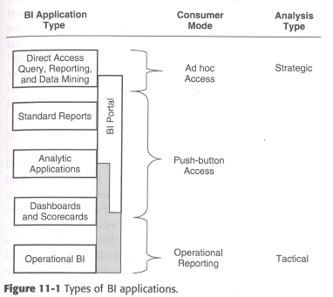
Types Of BI Applications and Consumer Modes…

Slide 18
Direct Access Query & Reporting Tools
Power users have access to software and the dimensional model for writing their own queries.
4 Key Functions of these tools:
Query Formulation – assist with data queries
Analysis & Presentation Capabilities – placing the data in “presentation quality” format.
User Experience – Metadata access, easy to use, prevent misuse of data.
Technical Features – Multitasking, Scheduling, Import / Export.
Examples: MS Excel, Hyperion

Slide 19
Standard Reports
The basic end of the BI Spectrum. Canned reports with pre-defined output.
Some reports are parameter-based.
Examples: MS Reporting Services, Hyperion Workspace

Slide 20
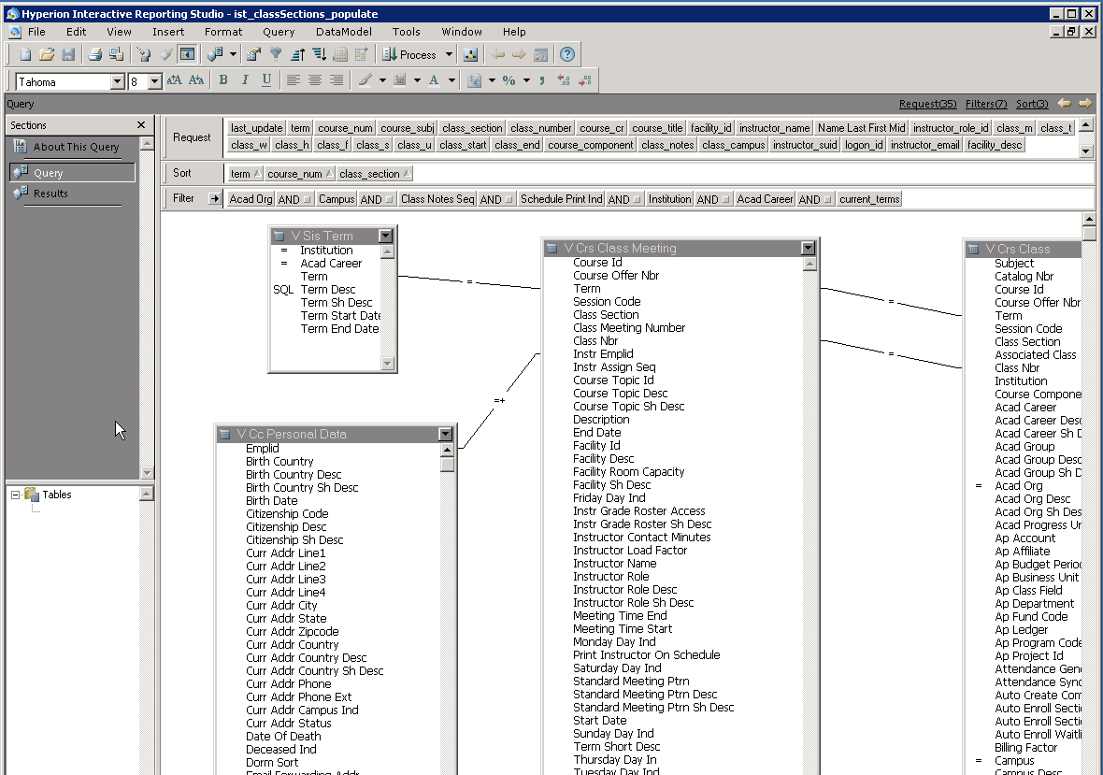
Example: Reporting Tool (Hyperion)

Slide 21
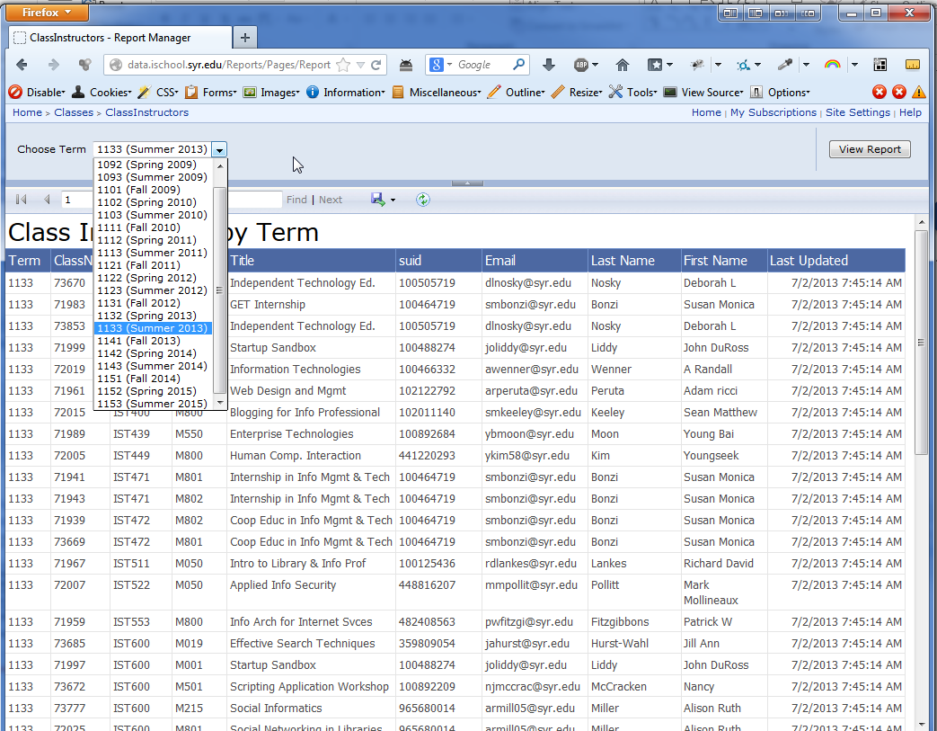
Example: Reports (SQL Reporting Services)

Slide 22
Analytic Applications
Targeted at specific business processes
Encapsulate domain-specific expertise
Can be purchased pre-built from vendors
Implementations of Data Mining / Machine Learning.
Examples:
Web path analysis
Shelf Space Planning
Fraud Detection

Slide 23
Data Mining
A process of data exploration with the intent to find patterns or relationships of organizational value.
Uses:
Clustering & Classifying data – “customer 1 is type A, customer 2 is type B”
Estimating and predicting – “customer type A will spend $N this year.”
Affinity Grouping – “customers who by product X are also likely to buy product Y”
Anomaly Detection – Fraud detection, unusual patterns

Slide 24
Data Mining Case Study
New York Times “How Companies Learn Your Secrets”
https://www.nytimes.com/2012/02/19/magazine/shopping-habits.html
Video:
http://nyti.ms/16ZgJcN

Slide 25
Dashboard & Scorecards
Originally executive interfaces, now organization-wide.
Provide a high-density & information-rich visual representation of data.
Usually web-based and interactive.
Contain KPI’s (Key performance Indicators) for measuring goals.
As much of an organizational challenge as it is a technical one…

Slide 26
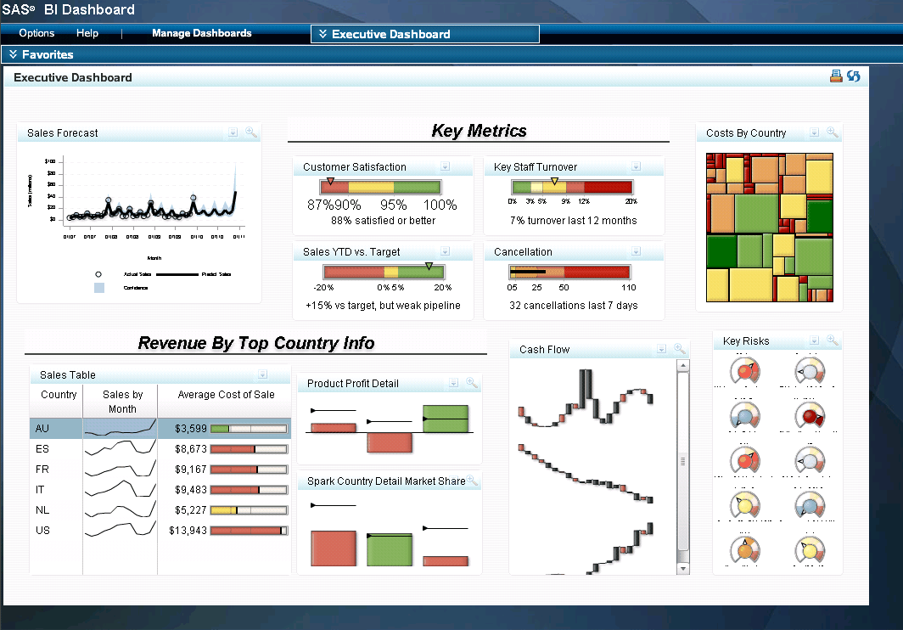
Example: Dashboard

Slide 27
Operational BI
As the name implies, BI targeted at the operational level.
Sometimes called “real-time” BI, due to the fact it operates on transactional data.
Examples:
Call centers can use it to obtain timely information regarding the customer on the line.
Analyzing event data from servers to diagnose issues.

Slide 28
The BI Portal
Provides access to BI Applications + Data
Security can be setup to restrict access.
Makes it easier to navigate a large BI implementation
Requirements of a portal:
Useable – Easy to find what you need.
Content Rich – Reports and More
Clean – Simple design not overwhelming
Current – New content often
Interactive – Browse data, customization for relevance
Value oriented – Users need to see value in it

Slide 29
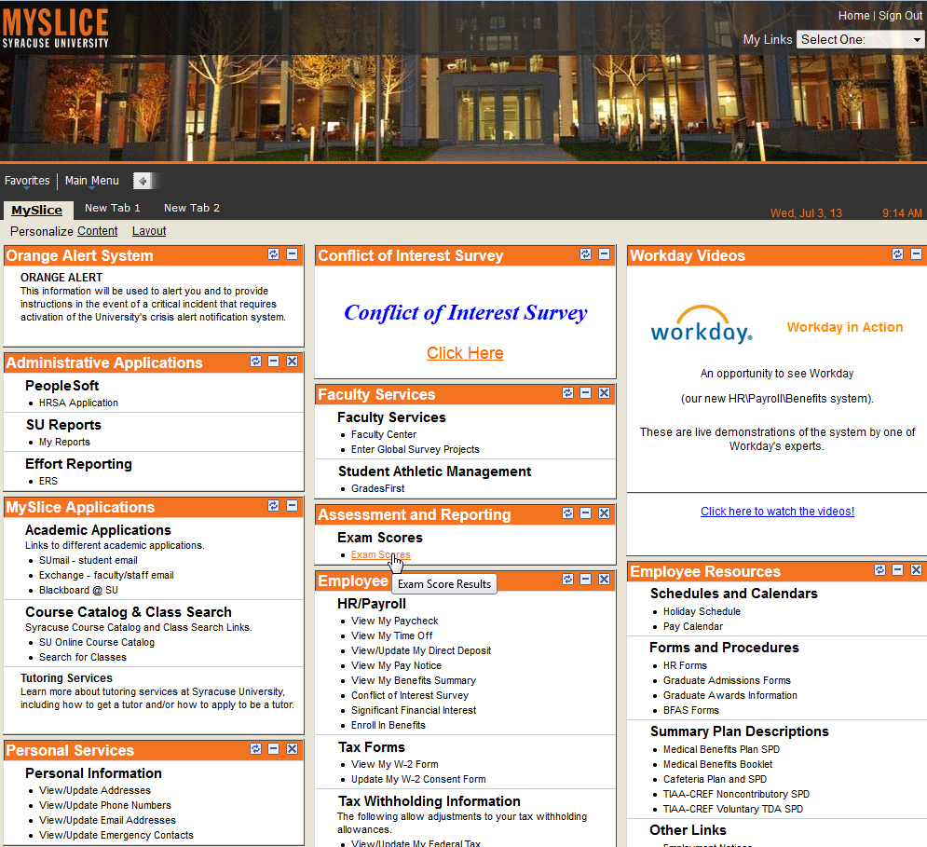
SU Myslice Portal
Useable
Content Rich
Clean
Current
Interactive
Value oriented

Slide 30
Analytic Cycle for BI Analysis
Monitor Activity
Identify Expectations
Determine Causal Factors
Model Alternatives
Take Action and Track Results
A Model for BI Development
Improve BI through feedback
This helps us :
Understand how our users will use BI
Determine the tools we must provide to make their experience positive & productive

Slide 31
Summary
Business intelligence is part of the front-room architecture accessible by users.
There are a variety of BI applications to suit different types of users within the organization.
To be successful, BI must be Useable, Content-Rich, Clean, Current, Interactive, and Value-Oriented
BI development is cyclical and you need to solicit input and feedback from users.
BI should be useful and easy to use.

Slide 32
IST722 Data Warehousing
Master Data Management and Data Governance
Business Intelligence Design and Development
Michael A. Fudge, Jr.

